Slide 1
Sacramento F5 User Group F5 Fundamental IP Security Controls & OWASP 2017 Top Ten
March 14, 2018
Chas Lesley, SE, CISSP

Slide 2
Today’s Agenda …
11:00am – 11:10am: Meet/Greet (Wait for stragglers)
11:10am – 11:15am: Intro/Business
11:15am – 12:00pm: User Group Presentation
12:00pm – 12:30pm: Lunch (THANK YOU JANET!)
12:30pm – 1:00pm: User Group Presentation
1:00pm – Wrap-up!
THANK YOU FOR COMING!

Slide 3










Today’s Objective …
Every environment is at different levels across the F5 product spectrum (Today’s discussion that’s LTM, APM & ASM)
Today we are covering frequently asked security questions for implementing fundamental security strategies
We want everyone to be able to walk away today with some tip, some configuration, some strategy that will help them solve a problem tomorrow.
We don’t know everything,
Everyone needs to contribute.

Slide 4







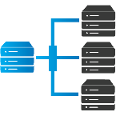
So where do we start …
Delivery & Traffic
Security Controls
[LTM]
Access
Security Controls
[APM]
Application
Security Controls
[ASM]

Slide 5







Local Traffic Manager
Access Policy Manager
App Security Manager
[LTM]
[APM]
[ASM]
Topics Covered
Topics Covered
Topics Covered
IP Intelligence
Geo-Location
IP Filters
IP Intelligence
Geo-Location
IP Filters
Access Controls
URI Controls
IP Intelligence
Geo-Location
IP Filters
OWASP 2017 Protections
BoT Defense
Examples
iRules
Traffic Policies
Examples
Control Objects
Policies
Examples
Protections
Policies

Slide 6
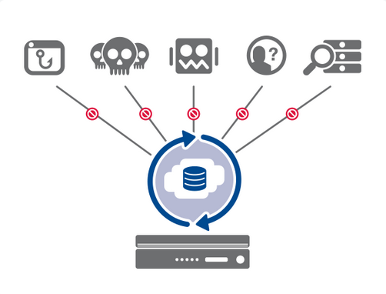






LTM: IP Intelligence
Phishing
Denial of Service
Botnets
Anonymous Proxies
Scanners
Threat Intelligence Feed
Subscription Service
Can be leveraged in all F5 modules
Notes:
IP Intelligence: https://f5.com/products/modules/ip-intelligence-services

Slide 7
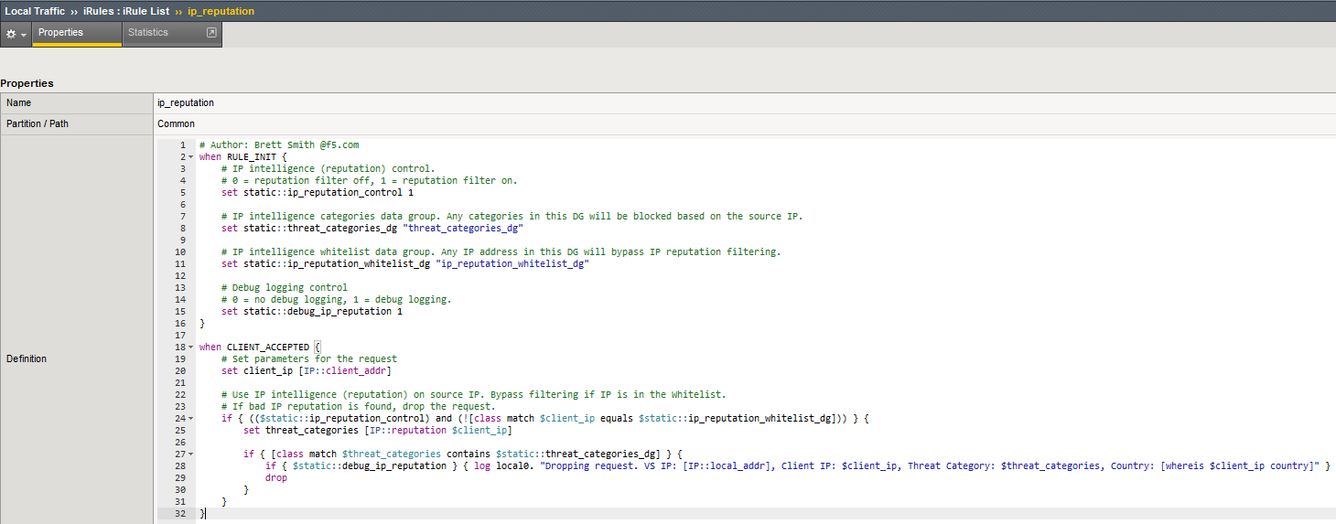
LTM: IP Intelligence
iRule Implementation
Available on DevCentral
https://devcentral.f5.com/wiki/iRules.IP-intelligence-reputation-blocking-with-whitelist-support.ashx
Notes:
https://devcentral.f5.com/wiki/iRules.IP-intelligence-reputation-blocking-with-whitelist-support.ashx

Slide 8
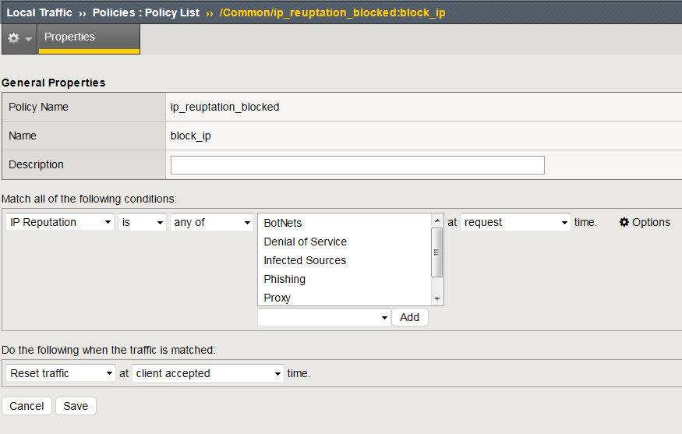
LTM: IP Intelligence
Traffic Policy Implementation
Notes:
IP Intelligence: https://f5.com/products/modules/ip-intelligence-services

Slide 9
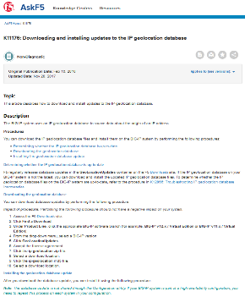
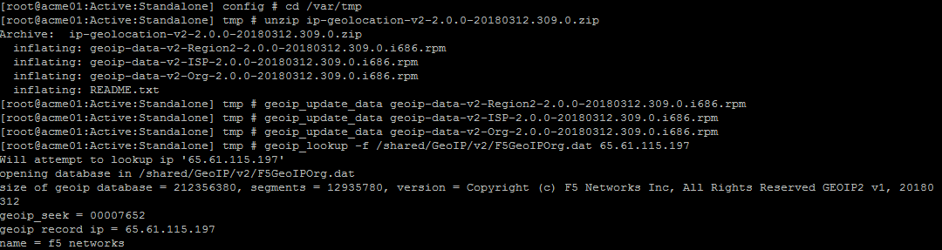
LTM: Geo-Location
Solution Article: K11176 (Manual, Quarterly)
Can be leveraged in all F5 modules
Script the update (save running all the commands)
Notes:
Geo Location Manual Update: https://support.f5.com/csp/article/K11176
Geo Location Auto Update (Community Release): https://devcentral.f5.com/codeshare/auto-updates-geoip-database-on-big-ip-1061

Slide 10
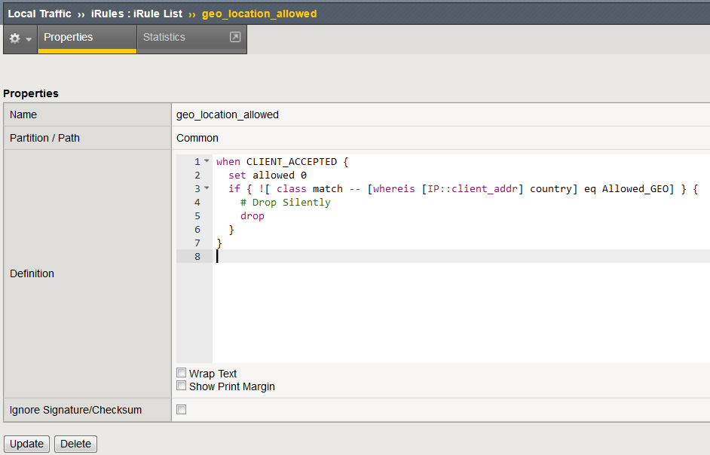
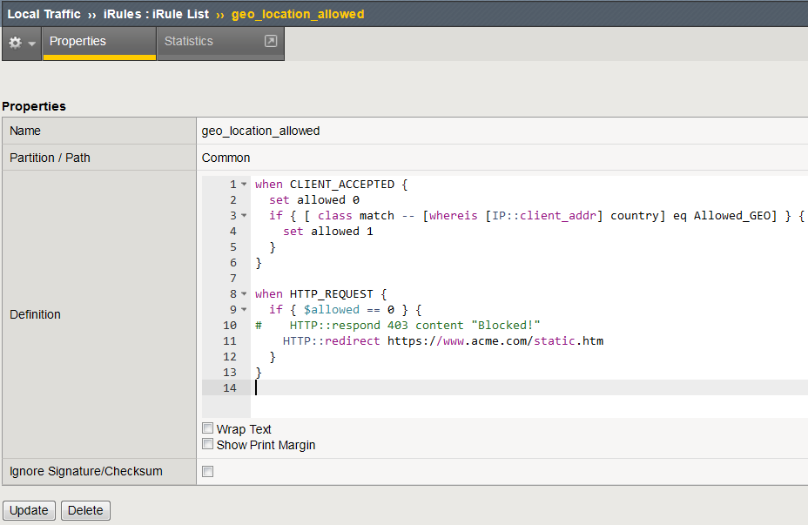
LTM: Geo-Location
iRule Implementation
CLIENT_ACCEPTED
(IP/TCP Event)
HTTP_REQUEST
(HTTP_Event)

Slide 11
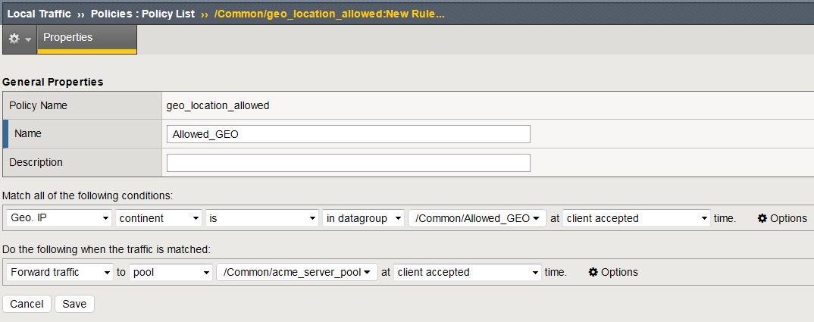
LTM: Geo-Location
Traffic Policy Implementation

Slide 12
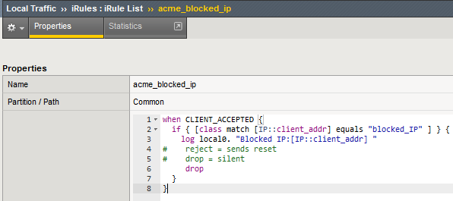
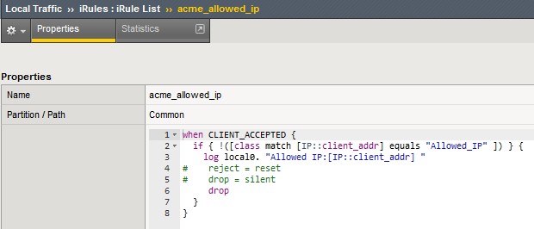
LTM: IP Filters
Leverage Datagroups
Can be IP or subnets
Update via REST
iRule Implementation
[Negative Enforcement]
[Positive Enforcement]
Notes:
Update via Data Group: https://devcentral.f5.com/codeshare/update-a-datagroup-using-rest-and-powershell-982

Slide 13
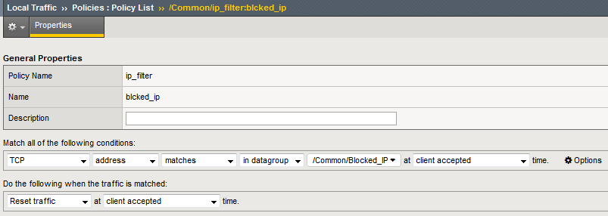
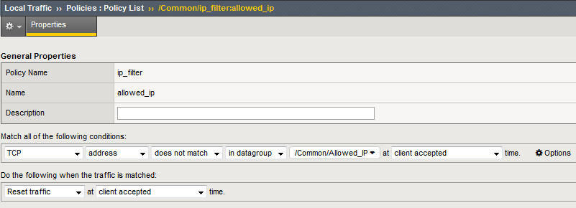
LTM: IP Filters
[Negative Enforcement]
Traffic Policy Implementation
[Positive Enforcement]
Notes:
Update via Datagroup: https://devcentral.f5.com/codeshare/update-a-datagroup-using-rest-and-powershell-982

Slide 14
Local Traffic Manager
Access Policy Manager
App Security Manager
[LTM]
[APM]
[ASM]
Topics Covered
Topics Covered
Topics Covered
IP Intelligence
Geo-Location
IP Filters
IP Intelligence
Geo-Location
IP Filters
Access Controls
URI Controls
IP Intelligence
Geo-Location
IP Filters
OWASP 2017 Protections
BoT Defense
Examples
iRules
Traffic Policies
Examples
Control Objects
Policies
Examples
Protections
Policies

Slide 15
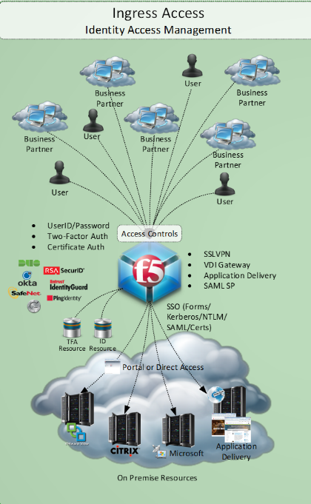
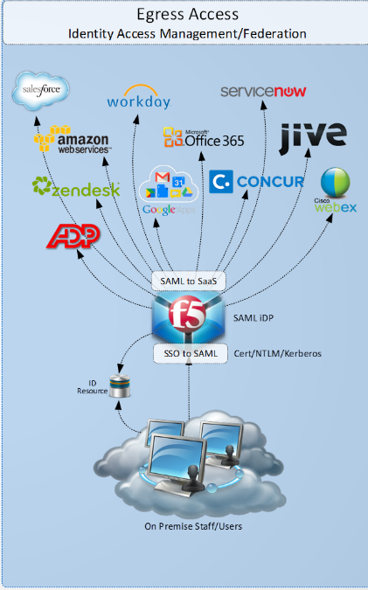
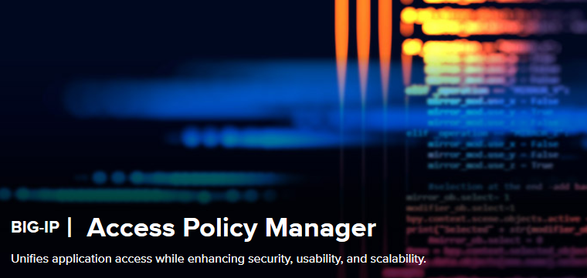
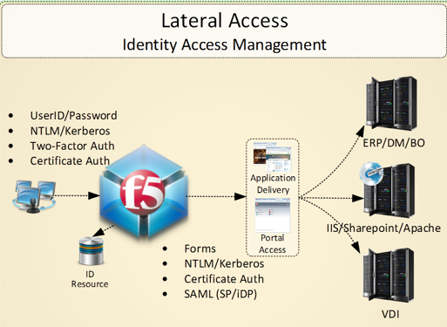
APM: Quick Overview
Identity Aware Proxy
All F5 things authentication
Access Control & SSO
Federation (SAML/oAuth)
MFA Integration & Control
VDI Proxy Remote Access
Adaptive Access & Visual Policy Creation

Slide 16
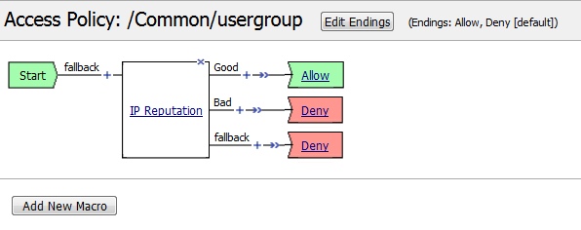
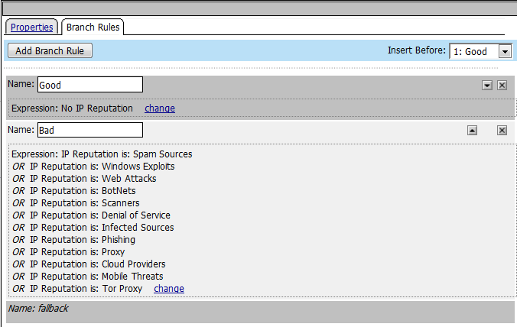
APM: IP Intelligence

Slide 17
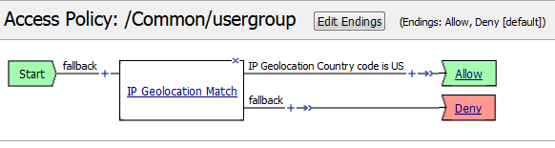
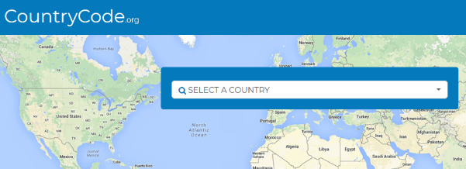
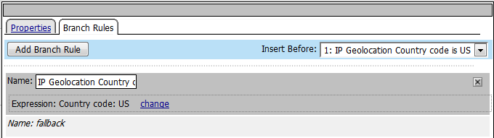
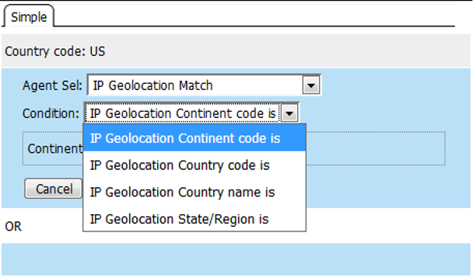
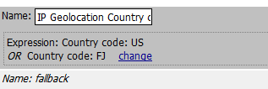
APM: Geo-Location
https://countrycode.org/

Slide 18
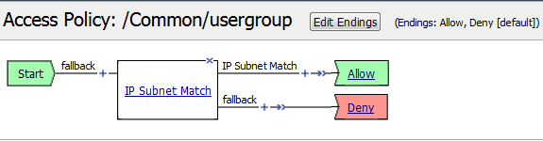
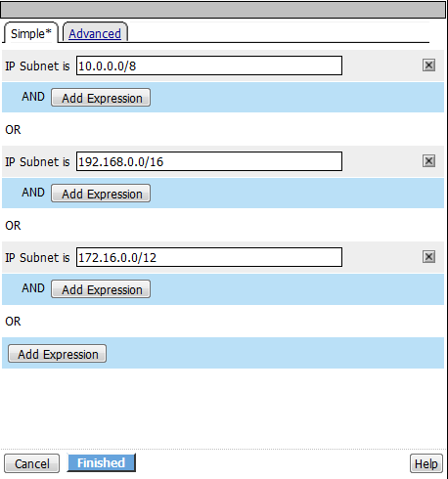
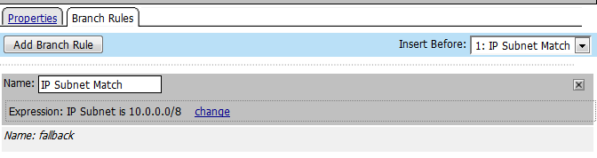
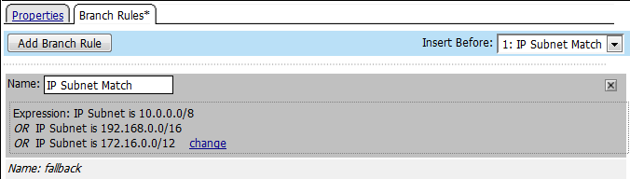
APM: IP Filters/Subnetting

Slide 19

APM: Access Control
Browser
Network quality and availability
OS
Connection integrity
Device type and integrity
Operating system
Location
Access method
Network integrity
!!!
v3.1
App importance and risk
App type/ version
App location
Authentication
Authentication
Control access before exposing the application

Slide 20
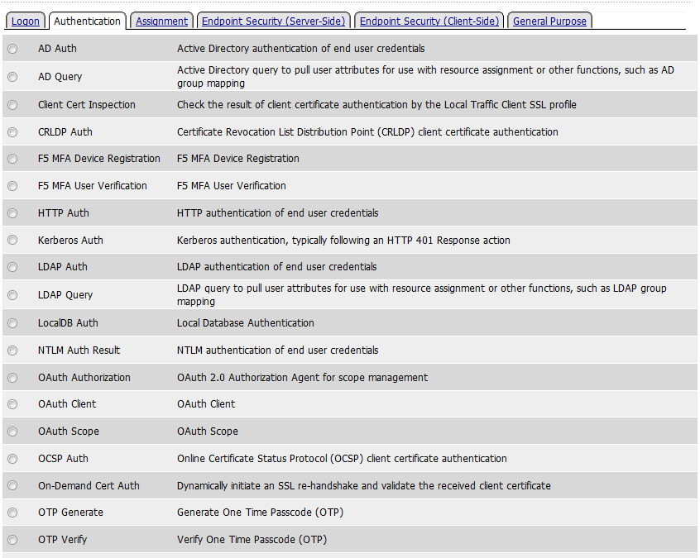

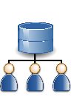




APM: Access Controls
Certificate Authentication
AD/LDAP Authentication
Federation (SAML/oAuth)
Multi-Factor Auth (MFA)
Client Gating Criteria

Slide 21
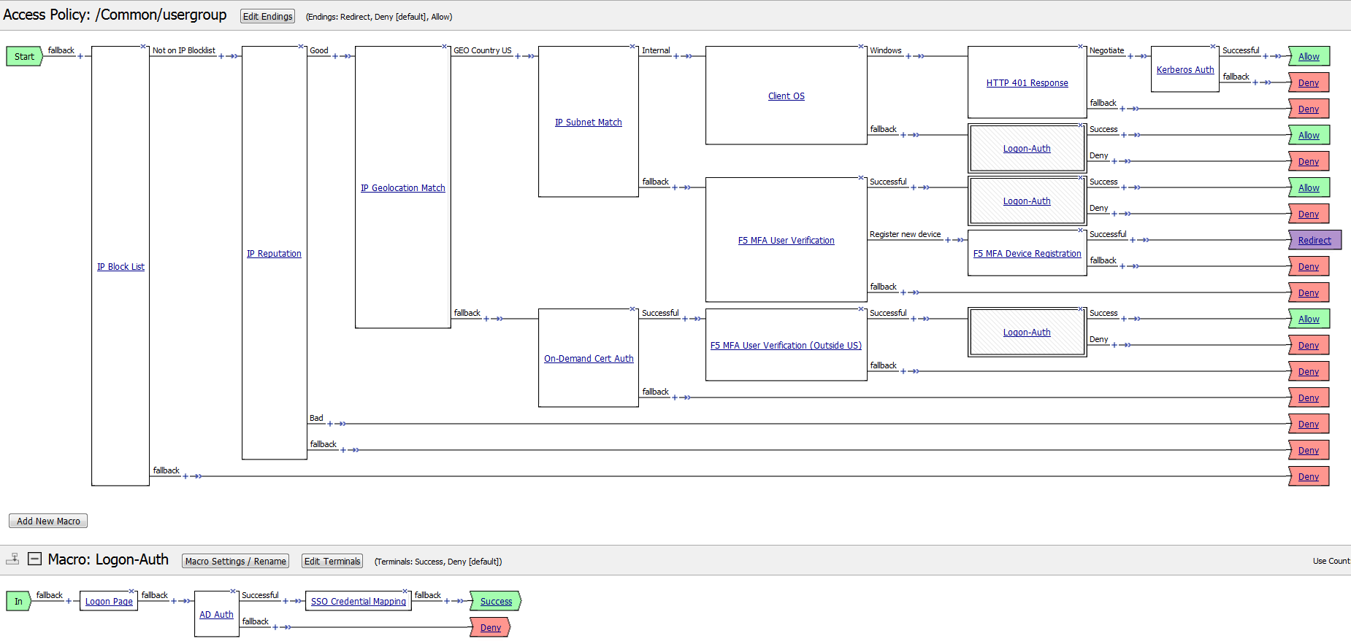
APM: Access Controls

Slide 22
APM: URI Controls
Per SESSION Policies
ONLY occurs at Session Start
Per REQUEST Policies
Processed EVERY Request
Step up Authentication
Acceptable Use
Coarse/Fine Authorization
Header/Cookie Insert/Modification
Authentication Events
Establishes Session/Session Variables
“Access Policy” Events

Slide 23
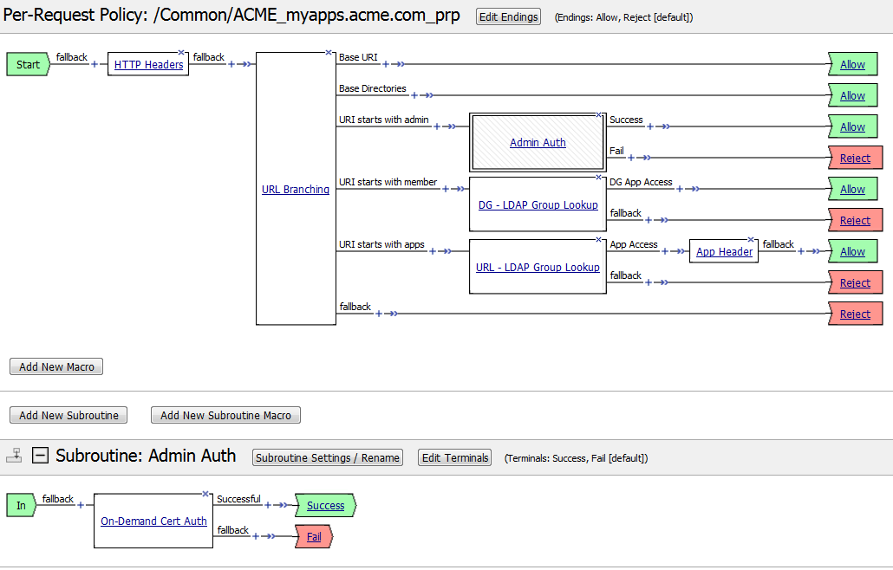
APM: URI Controls
Applies …
BEFORE first access
DURING continued access

Slide 24
Local Traffic Manager
Access Policy Manager
App Security Manager
[LTM]
[APM]
[ASM]
Topics Covered
Topics Covered
Topics Covered
IP Intelligence
Geo-Location
IP Filters
IP Intelligence
Geo-Location
IP Filters
Access Controls
URI Controls
IP Intelligence
Geo-Location
IP Filters
OWASP 2017 Protections
BoT Defense
Examples
iRules
Traffic Policies
Examples
Control Objects
Policies
Examples
Protections
Policies

Slide 25
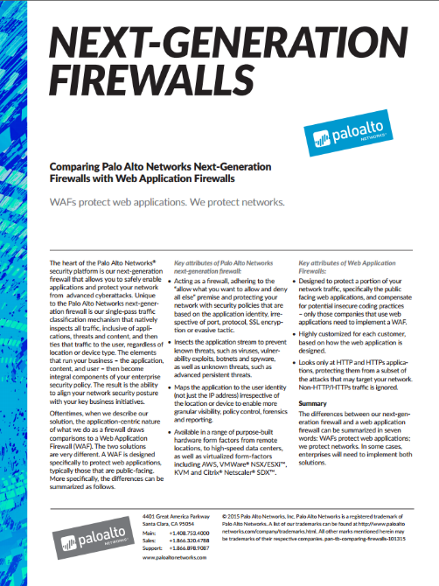
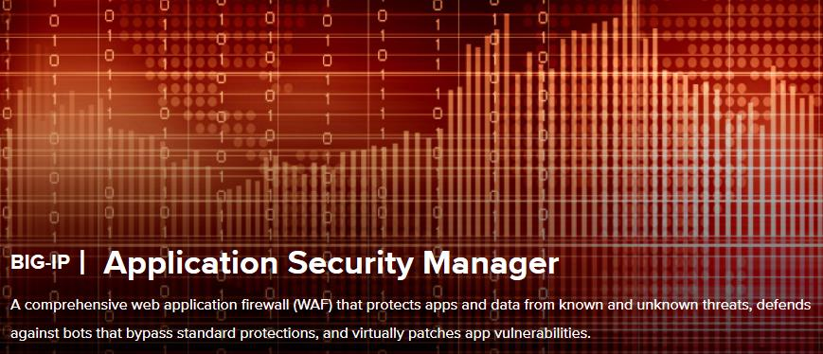
ASM: Quick Overview
Web Application Firewall
Protects Web Applications at Layer 7
URLs & URL Flows
File Types & Parameters
Methods & Sessions
and more …
“WAFs protect web applications. We protect networks.”
Notes:
https://f5.com/products/big-ip/application-security-manager-asm
https://www.paloaltonetworks.com/resources/techbriefs/palo-alto-networks-vs-web-application-firewalls

Slide 26
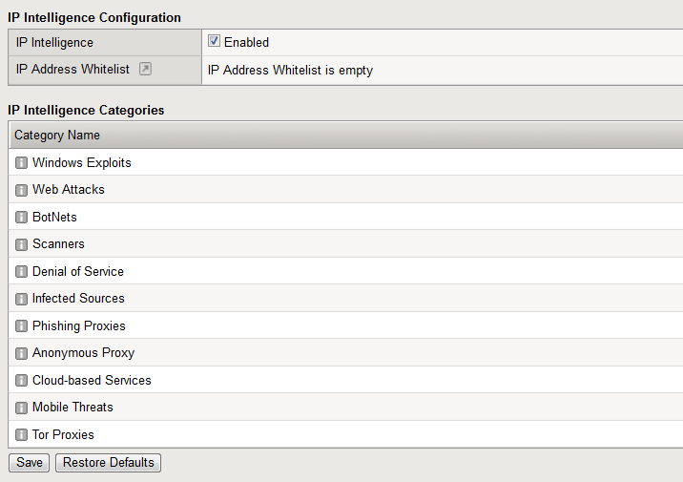
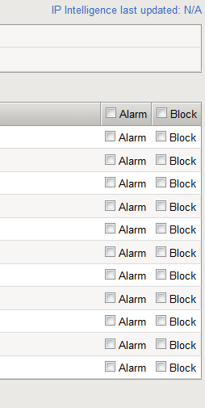
ASM: IP Reputation
Security ›› Application Security : IP Addresses : IP Intelligence

Slide 27
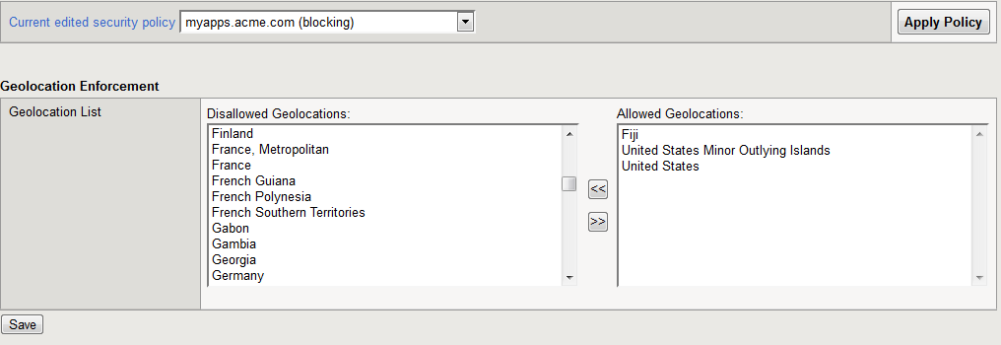
ASM: Geo-Location
Security ›› Application Security : Geolocation Enforcement

Slide 28
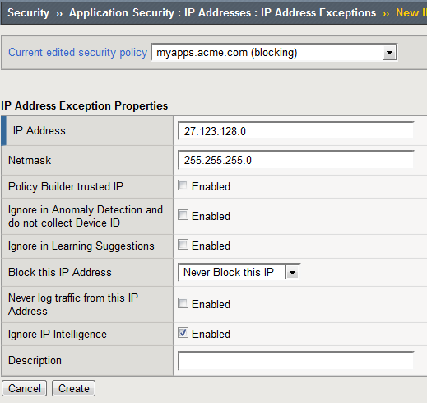
ASM: IP Controls
Security ›› Application Security : IP Addresses : IP Address Exceptions
Enforce positive or negative security models
Mark as trusted IP
Ignore learning = great for Vulnerability Scanners
Can filter more specifically on other security controls (ex DDoS enforcement)

Slide 29
ASM: OWASP Top Ten 2017
The Open Web Application Security Project (OWASP) is an open community dedicated to enabling organizations to develop, purchase, and maintain applications and APIs that can be trusted.
OWASP is not affiliated with any technology company,
although OWASP supports the informed use of commercial security technology. OWASP produces many types of materials in a collaborative, transparent, and open way.
Notes:
https://www.owasp.org/images/7/72/OWASP_Top_10-2017_%28en%29.pdf.pdf

Slide 30
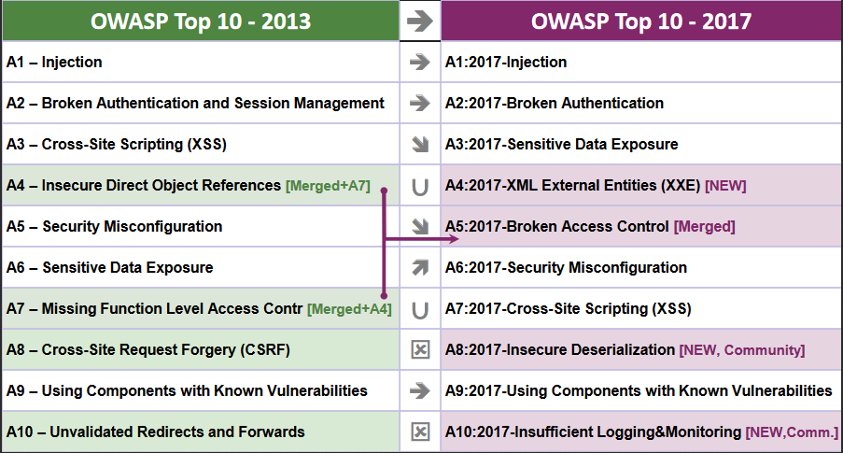
ASM: OWASP Top Ten 2017
Notes:
https://www.owasp.org/images/7/72/OWASP_Top_10-2017_%28en%29.pdf.pdf

Slide 31


ASM: OWASP Disclaimer
F5 can greatly assist, enhance, enable organizations to address OWASP Top Ten issues. It is not the be all, end all silver bullet - there are many aspects & layers to consider. (ex network, client, host etc etc)
There is always the question of “can I” versus “should I”. There is often overlap when applying security layers – be prudent and purposeful in your strategy.

Slide 32
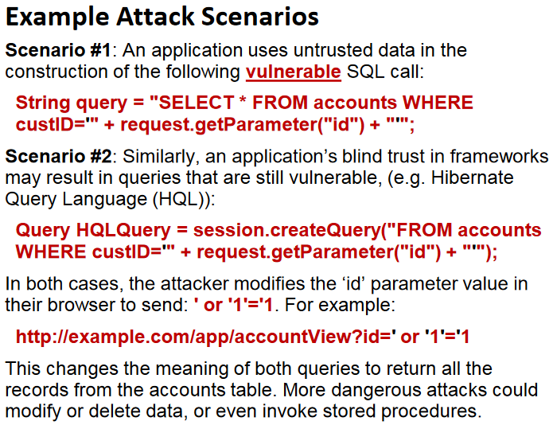
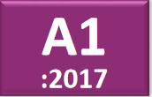
ASM: A1 - Injection
Injection flaws are very prevalent, particularly in legacy code. Injection vulnerabilities are often found in SQL, LDAP, XPath, or NoSQL queries, OS commands, XML parsers, SMTP headers, expression languages, and ORM queries. Injection flaws are easy to discover when examining code. Scanners and fuzzers can help attackers find injection flaws.
Notes:
OWASP Top Ten 2017:
https://www.owasp.org/images/7/72/OWASP_Top_10-2017_%28en%29.pdf.pdf

Slide 33
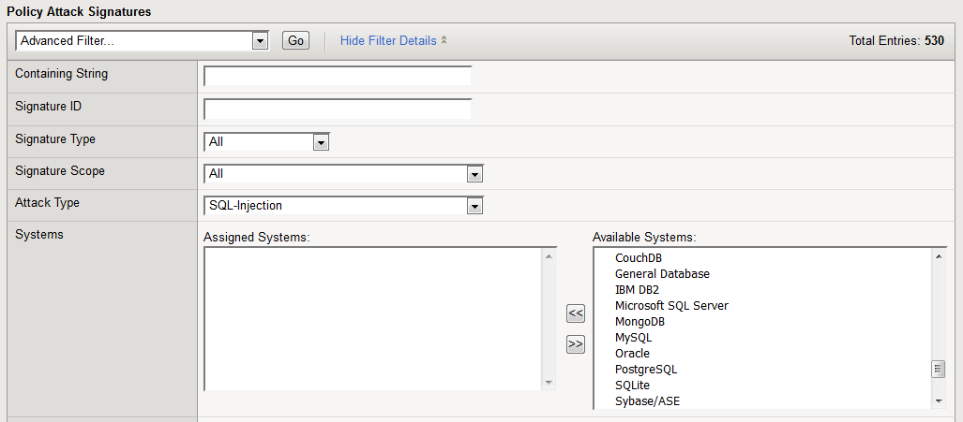
ASM: A1 - Injection
Attack signatures
Meta character restrictions
Parameter value length restrictions
Security ›› Application Security : Attack Signatures
530 available SQL Injection Attack Signatures
Notes:
OWASP Top 10 - 2017 vs. BIG-IP ASM:
https://devcentral.f5.com/articles/big-ip-asm-and-the-owasp-top-10-2017-28911
Attack Signatures:
Working With Signatures: https://support.f5.com/kb/en-us/products/big-ip_asm/manuals/product/asm-bot-and-attack-signature-reference-12-1-0/1.html
Updating Signatures: https://support.f5.com/csp/article/K8217
Metacharacters:
Values: https://support.f5.com/kb/en-us/products/big-ip_asm/manuals/product/asm-implementations-12-1-0/27.html#unique_1449170054
Names: https://support.f5.com/kb/en-us/products/big-ip_asm/manuals/product/asm-implementations-12-1-0/27.html#unique_2125157892
Parameters:
Adding Parameters: https://support.f5.com/kb/en-us/products/big-ip_asm/manuals/product/asm-implementations-12-1-0/27.html#unique_266844492

Slide 34
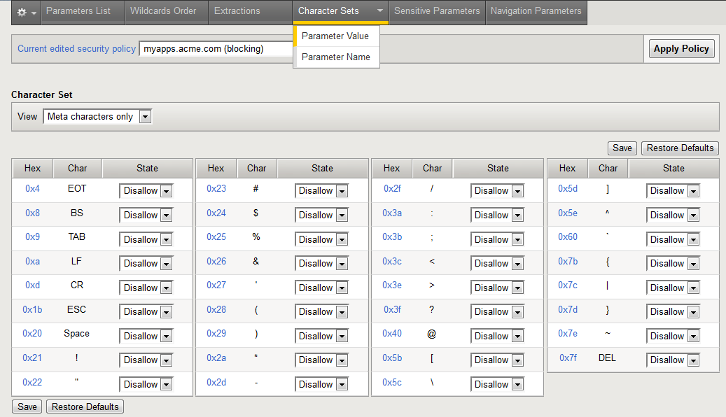
ASM: A1 - Injection
Attack signatures
Meta character restrictions
Parameter value length restrictions
Security ›› Application Security : Parameters : Character Sets
Meta Character restrictions for Values & Names
Notes:
OWASP Top 10 - 2017 vs. BIG-IP ASM:
https://devcentral.f5.com/articles/big-ip-asm-and-the-owasp-top-10-2017-28911
Attack Signatures:
Working With Signatures: https://support.f5.com/kb/en-us/products/big-ip_asm/manuals/product/asm-bot-and-attack-signature-reference-12-1-0/1.html
Updating Signatures: https://support.f5.com/csp/article/K8217
Metacharacters:
Values: https://support.f5.com/kb/en-us/products/big-ip_asm/manuals/product/asm-implementations-12-1-0/27.html#unique_1449170054
Names: https://support.f5.com/kb/en-us/products/big-ip_asm/manuals/product/asm-implementations-12-1-0/27.html#unique_2125157892
Parameters:
Adding Parameters: https://support.f5.com/kb/en-us/products/big-ip_asm/manuals/product/asm-implementations-12-1-0/27.html#unique_266844492

Slide 35
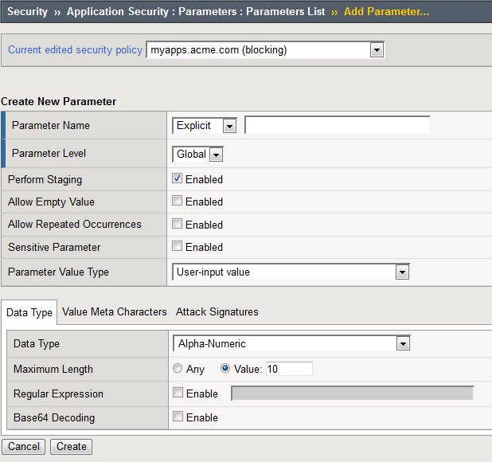
ASM: A1 - Injection
Security ›› Application Security : Parameters
Attack signatures
Meta character restrictions
Parameter value length restrictions
Multiple Controls including Value Length
Notes:
OWASP Top 10 - 2017 vs. BIG-IP ASM:
https://devcentral.f5.com/articles/big-ip-asm-and-the-owasp-top-10-2017-28911
Attack Signatures:
Working With Signatures: https://support.f5.com/kb/en-us/products/big-ip_asm/manuals/product/asm-bot-and-attack-signature-reference-12-1-0/1.html
Updating Signatures: https://support.f5.com/csp/article/K8217
Metacharacters:
Values: https://support.f5.com/kb/en-us/products/big-ip_asm/manuals/product/asm-implementations-12-1-0/27.html#unique_1449170054
Names: https://support.f5.com/kb/en-us/products/big-ip_asm/manuals/product/asm-implementations-12-1-0/27.html#unique_2125157892
Parameters:
Adding Parameters: https://support.f5.com/kb/en-us/products/big-ip_asm/manuals/product/asm-implementations-12-1-0/27.html#unique_266844492

Slide 36
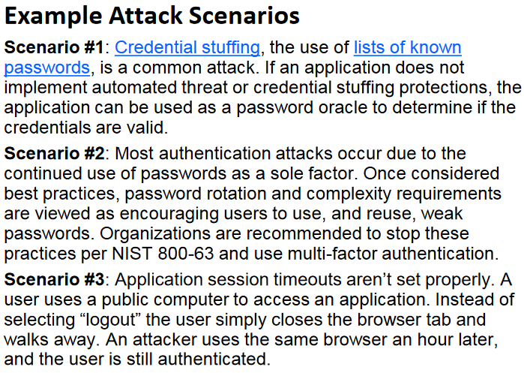
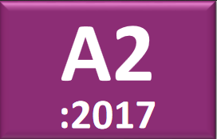
ASM: A2 - Broken Authentication
Broken Authentication is widespread due to the design and implementation of most identity and access controls. Session
management is the bedrock of authentication and access controls, and is present in all stateful applications. Attackers can detect broken authentication using
manual means and exploit them using automated tools with password lists and dictionary
attacks.
Notes:
OWASP Top Ten 2017:
https://www.owasp.org/images/7/72/OWASP_Top_10-2017_%28en%29.pdf.pdf

Slide 37
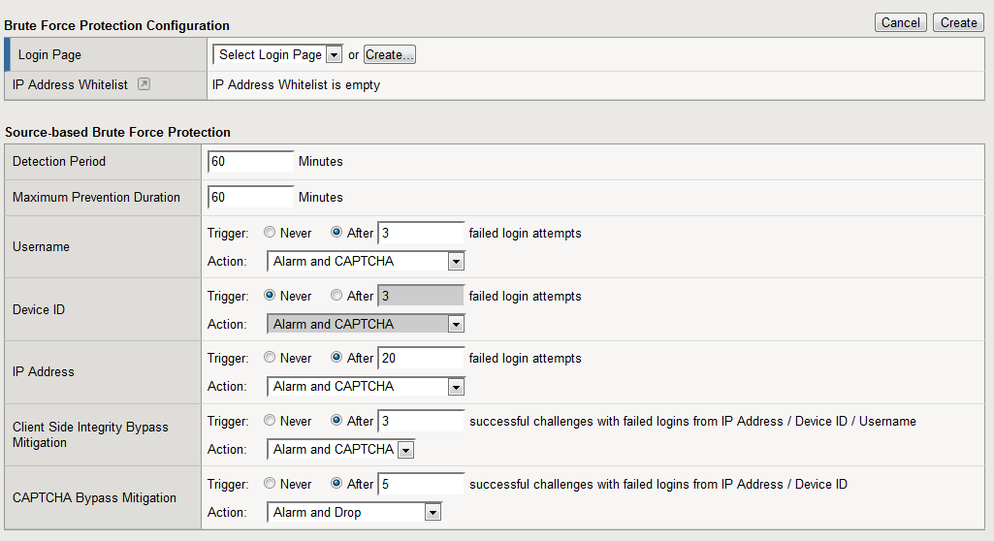
ASM: A2 – Broken Authentication
Brute Force protection
Credentials Stuffing protection
Login Enforcement
Session tracking
HTTP cookie tampering protection
Session hijacking protection
Security ›› Application Security : Anomaly Detection : Brute Force Attack Prevention
Notes:
OWASP Top 10 - 2017 vs. BIG-IP ASM:
https://devcentral.f5.com/articles/big-ip-asm-and-the-owasp-top-10-2017-28911
Brute Force & Credential Stuffing
https://devcentral.f5.com/articles/mitigating-sentry-mba-credentials-stuffing-threat-24723
Login Enforcement
https://support.f5.com/kb/en-us/products/big-ip_asm/manuals/product/asm-implementations-12-1-0/5.html
Session Tracking & Hijacking
https://support.f5.com/kb/en-us/products/big-ip_asm/manuals/product/asm-implementations-12-1-0/15.html
Cookie Tampering
https://support.f5.com/csp/article/K57420543

Slide 38
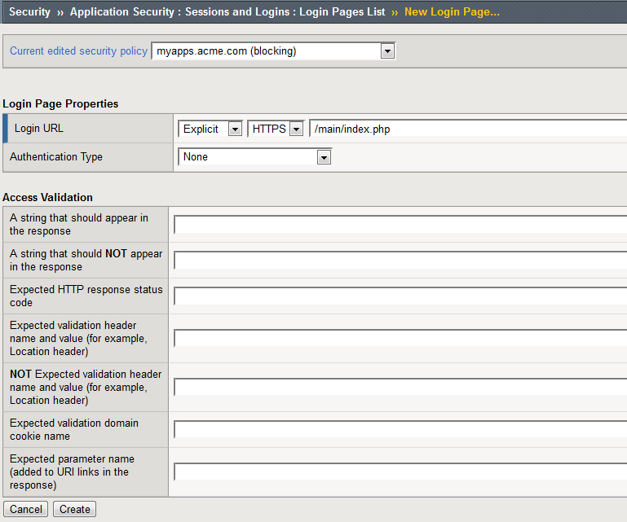
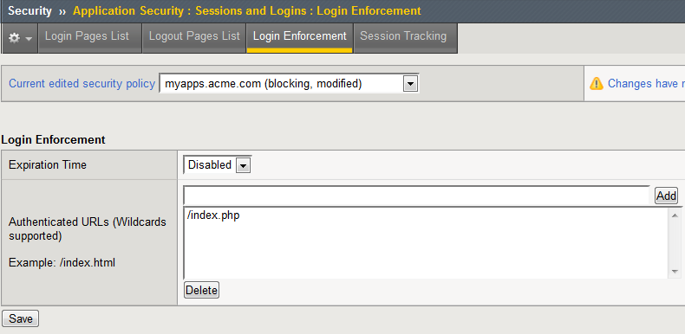
ASM: A2 – Broken Authentication
Brute Force protection
Credentials Stuffing protection
Login Enforcement
Session tracking
HTTP cookie tampering protection
Session hijacking protection
Security ›› Application Security : Sessions and Logins : Login Pages List
Security ›› Application Security : Sessions and Logins : Login Enforcement
Notes:
Brute Force & Credential Stuffing
https://devcentral.f5.com/articles/mitigating-sentry-mba-credentials-stuffing-threat-24723
Login Enforcement
https://support.f5.com/kb/en-us/products/big-ip_asm/manuals/product/asm-implementations-12-1-0/5.html
Session Tracking & Hijacking
https://support.f5.com/kb/en-us/products/big-ip_asm/manuals/product/asm-implementations-12-1-0/15.html
Cookie Tampering
https://support.f5.com/csp/article/K57420543

Slide 39
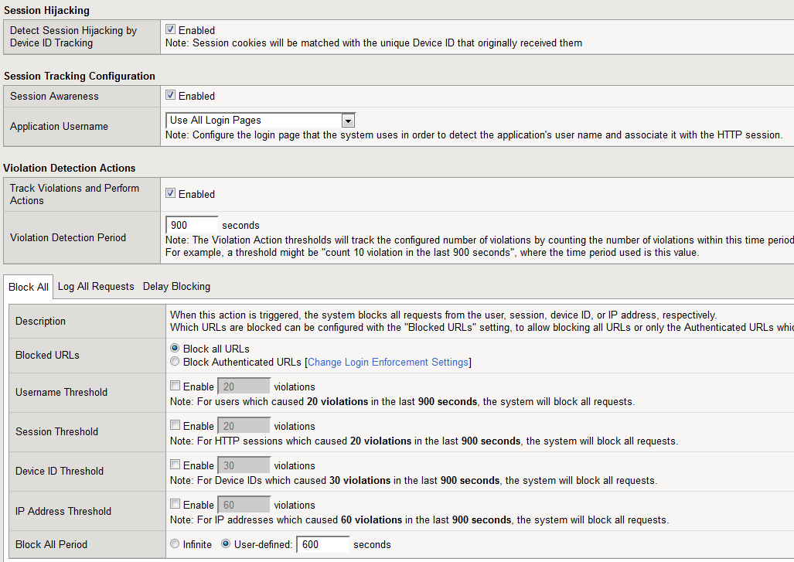
ASM: A2 – Broken Authentication
Brute Force protection
Credentials Stuffing protection
Login Enforcement
Session tracking
HTTP cookie tampering protection
Session hijacking protection
Security ›› Application Security : Sessions and Logins : Session Tracking
Session Tracking and Hijacking
Notes:
Brute Force & Credential Stuffing
https://devcentral.f5.com/articles/mitigating-sentry-mba-credentials-stuffing-threat-24723
Login Enforcement
https://support.f5.com/kb/en-us/products/big-ip_asm/manuals/product/asm-implementations-12-1-0/5.html
Session Tracking & Hijacking
https://support.f5.com/kb/en-us/products/big-ip_asm/manuals/product/asm-implementations-12-1-0/15.html
Cookie Tampering
https://support.f5.com/csp/article/K57420543

Slide 40

ASM: A2 – Broken Authentication
Brute Force protection
Credentials Stuffing protection
Login Enforcement
Session tracking
HTTP cookie tampering protection
Session hijacking protection
Security ›› Application Security : Headers : Cookies List
Notes:
Brute Force & Credential Stuffing
https://devcentral.f5.com/articles/mitigating-sentry-mba-credentials-stuffing-threat-24723
Login Enforcement
https://support.f5.com/kb/en-us/products/big-ip_asm/manuals/product/asm-implementations-12-1-0/5.html
Session Tracking & Hijacking
https://support.f5.com/kb/en-us/products/big-ip_asm/manuals/product/asm-implementations-12-1-0/15.html
Cookie Tampering
https://support.f5.com/csp/article/K57420543

Slide 41


ASM: A3 - Sensitive Data Exposure
This has been the most common impactful attack. The most common flaw is simply not encrypting sensitive data. When crypto is employed, weak key generation and management, and weak algorithm, protocol and cipher usage is common, particularly for weak password hashing storage techniques. For data in transit, server side weaknesses are mainly easy to detect, but hard for
data at rest.
Notes:
OWASP Top Ten 2017:
https://www.owasp.org/images/7/72/OWASP_Top_10-2017_%28en%29.pdf.pdf

Slide 42

ASM: A3 – Sensitive Data Exposure
Data Guard
Attack signatures (“Predictable Resource Location” and “Information Leakage”)
Security ›› Application Security : Data Guard
Notes:
OWASP Top 10 - 2017 vs. BIG-IP ASM:
https://devcentral.f5.com/articles/big-ip-asm-and-the-owasp-top-10-2017-28911
Attack Signatures:
Working With Signatures: https://support.f5.com/kb/en-us/products/big-ip_asm/manuals/product/asm-bot-and-attack-signature-reference-12-1-0/1.html
Updating Signatures: https://support.f5.com/csp/article/K8217
Data Guard
https://support.f5.com/kb/en-us/products/big-ip_asm/manuals/product/asm-implementations-12-1-0/11.html#conceptid

Slide 43


ASM: A3 – Sensitive Data Exposure
Data Guard
Attack signatures (“Predictable Resource Location” and “Information Leakage”)
Security ›› Application Security : Attack Signatures
Notes:
OWASP Top 10 - 2017 vs. BIG-IP ASM:
https://devcentral.f5.com/articles/big-ip-asm-and-the-owasp-top-10-2017-28911
Attack Signatures:
Working With Signatures: https://support.f5.com/kb/en-us/products/big-ip_asm/manuals/product/asm-bot-and-attack-signature-reference-12-1-0/1.html
Updating Signatures: https://support.f5.com/csp/article/K8217
Data Guard
https://support.f5.com/kb/en-us/products/big-ip_asm/manuals/product/asm-implementations-12-1-0/11.html#conceptid

Slide 44


ASM: A4 - XML External Entities (XXE)
Attackers can exploit vulnerable XML processors if they can upload XML or
include hostile content in an XML document, exploiting vulnerable code, dependencies or integrations.
Notes:
OWASP Top Ten 2017:
https://www.owasp.org/images/7/72/OWASP_Top_10-2017_%28en%29.pdf.pdf

Slide 45


ASM: A4 - XML External Entities (XXE)
Attack signatures (“Other Application Attacks” - XXE)
XML content profile (Disallow DTD)
Subset of API Protection
Security ›› Application Security : Attack Signatures
Notes:
OWASP Top 10 - 2017 vs. BIG-IP ASM:
https://devcentral.f5.com/articles/big-ip-asm-and-the-owasp-top-10-2017-28911
Attack Signatures:
Working With Signatures: https://support.f5.com/kb/en-us/products/big-ip_asm/manuals/product/asm-bot-and-attack-signature-reference-12-1-0/1.html
Updating Signatures: https://support.f5.com/csp/article/K8217
XML Content
https://support.f5.com/kb/en-us/products/big-ip_asm/manuals/product/asm-implementations-12-1-0/19.html

Slide 46

ASM: A4 - XML External Entities (XXE)
Attack signatures (“Other Application Attacks” - XXE)
XML content profile (Disallow DTD)
Subset of API Protection
Security ›› Application Security : Content Profiles : XML Profiles
Notes:
OWASP Top 10 - 2017 vs. BIG-IP ASM:
https://devcentral.f5.com/articles/big-ip-asm-and-the-owasp-top-10-2017-28911
Attack Signatures:
Working With Signatures: https://support.f5.com/kb/en-us/products/big-ip_asm/manuals/product/asm-bot-and-attack-signature-reference-12-1-0/1.html
Updating Signatures: https://support.f5.com/csp/article/K8217
XML Content
https://support.f5.com/kb/en-us/products/big-ip_asm/manuals/product/asm-implementations-12-1-0/19.html

Slide 47


ASM: A5 – Broken Access Control
Access Control weaknesses are common due to the lack of automated detection, and lack of effective functional testing by application developers.
Manual testing is the best way to detect missing or ineffective
access control, including HTTP method (GET vs PUT, etc), controller, direct object references, etc.
Notes:
OWASP Top Ten 2017:
https://www.owasp.org/images/7/72/OWASP_Top_10-2017_%28en%29.pdf.pdf

Slide 48

ASM: A5 – Broken Access Control
File types
Allowed/disallowed URLs
Login Enforcement
Session tracking
Attack signatures (“Directory traversal”)
Security ›› Application Security : File Types
Allowed/Disallowed File Types
Notes:
OWASP Top 10 - 2017 vs. BIG-IP ASM:
https://devcentral.f5.com/articles/big-ip-asm-and-the-owasp-top-10-2017-28911
File Types
https://support.f5.com/kb/en-us/products/big-ip_asm/manuals/product/asm-implementations-12-1-0/27.html#unique_887513989
URLs
https://support.f5.com/kb/en-us/products/big-ip_asm/manuals/product/asm-implementations-12-1-0/27.html#unique_1568736666
Login Enforcement
https://support.f5.com/kb/en-us/products/big-ip_asm/manuals/product/asm-implementations-12-1-0/5.html
Session Tracking & Hijacking
https://support.f5.com/kb/en-us/products/big-ip_asm/manuals/product/asm-implementations-12-1-0/15.html
Attack Signatures:
Working With Signatures: https://support.f5.com/kb/en-us/products/big-ip_asm/manuals/product/asm-bot-and-attack-signature-reference-12-1-0/1.html
Updating Signatures: https://support.f5.com/csp/article/K8217

Slide 49

ASM: A5 – Broken Access Control
File types
Allowed/disallowed URLs
Login Enforcement
Session tracking
Attack signatures (“Directory traversal”)
Security ›› Application Security : URLs
Allowed/Disallowed URLs
Notes:
OWASP Top 10 - 2017 vs. BIG-IP ASM:
https://devcentral.f5.com/articles/big-ip-asm-and-the-owasp-top-10-2017-28911
File Types
https://support.f5.com/kb/en-us/products/big-ip_asm/manuals/product/asm-implementations-12-1-0/27.html#unique_887513989
URLs
https://support.f5.com/kb/en-us/products/big-ip_asm/manuals/product/asm-implementations-12-1-0/27.html#unique_1568736666
Login Enforcement
https://support.f5.com/kb/en-us/products/big-ip_asm/manuals/product/asm-implementations-12-1-0/5.html
Session Tracking & Hijacking
https://support.f5.com/kb/en-us/products/big-ip_asm/manuals/product/asm-implementations-12-1-0/15.html
Attack Signatures:
Working With Signatures: https://support.f5.com/kb/en-us/products/big-ip_asm/manuals/product/asm-bot-and-attack-signature-reference-12-1-0/1.html
Updating Signatures: https://support.f5.com/csp/article/K8217

Slide 50

ASM: A5 – Broken Access Control
File types
Allowed/disallowed URLs
Login Enforcement
Session tracking
Attack signatures (“Directory traversal”)
Security ›› Application Security : Attack Signatures
Security ›› Application Security : URLs : Flows List
Notes:
OWASP Top 10 - 2017 vs. BIG-IP ASM:
https://devcentral.f5.com/articles/big-ip-asm-and-the-owasp-top-10-2017-28911
File Types
https://support.f5.com/kb/en-us/products/big-ip_asm/manuals/product/asm-implementations-12-1-0/27.html#unique_887513989
URLs
https://support.f5.com/kb/en-us/products/big-ip_asm/manuals/product/asm-implementations-12-1-0/27.html#unique_1568736666
Login Enforcement
https://support.f5.com/kb/en-us/products/big-ip_asm/manuals/product/asm-implementations-12-1-0/5.html
Session Tracking & Hijacking
https://support.f5.com/kb/en-us/products/big-ip_asm/manuals/product/asm-implementations-12-1-0/15.html
Attack Signatures:
Working With Signatures: https://support.f5.com/kb/en-us/products/big-ip_asm/manuals/product/asm-bot-and-attack-signature-reference-12-1-0/1.html
Updating Signatures: https://support.f5.com/csp/article/K8217

Slide 51


ASM: A6 – Security Misconfiguration
Security Misconfiguration can happen at any level of an application stack. Automated scanners are useful for detecting misconfigurations, use of default accounts or configurations, unnecessary services, legacy options, etc.
Notes:
OWASP Top Ten 2017:
https://www.owasp.org/images/7/72/OWASP_Top_10-2017_%28en%29.pdf.pdf

Slide 52


ASM: A6 – Security Misconfiguration
Attack Signatures
DAST Integration
Allowed Methods
HTML5 Cross-Domain Request Enforcement
Security ›› Application Security : Vulnerability Assessments
Notes:
OWASP Top 10 - 2017 vs. BIG-IP ASM:
https://devcentral.f5.com/articles/big-ip-asm-and-the-owasp-top-10-2017-28911
Attack Signatures:
Working With Signatures: https://support.f5.com/kb/en-us/products/big-ip_asm/manuals/product/asm-bot-and-attack-signature-reference-12-1-0/1.html
Updating Signatures: https://support.f5.com/csp/article/K8217
DAST Intergration
https://support.f5.com/kb/en-us/products/big-ip_asm/manuals/product/asm-getting-started-12-0-0/5.html
Methods
https://support.f5.com/csp/article/K12312
CORS
https://support.f5.com/kb/en-us/products/big-ip_asm/manuals/product/asm-implementations-12-1-0/17.html

Slide 53


ASM: A6 – Security Misconfiguration
Attack Signatures
DAST Integration
Allowed Methods
HTML5 Cross-Domain Request Enforcement
Security ›› Application Security : Headers : Methods
Notes:
OWASP Top 10 - 2017 vs. BIG-IP ASM:
https://devcentral.f5.com/articles/big-ip-asm-and-the-owasp-top-10-2017-28911
Attack Signatures:
Working With Signatures: https://support.f5.com/kb/en-us/products/big-ip_asm/manuals/product/asm-bot-and-attack-signature-reference-12-1-0/1.html
Updating Signatures: https://support.f5.com/csp/article/K8217
DAST Intergration
https://support.f5.com/kb/en-us/products/big-ip_asm/manuals/product/asm-getting-started-12-0-0/5.html
Methods
https://support.f5.com/csp/article/K12312
CORS
https://support.f5.com/kb/en-us/products/big-ip_asm/manuals/product/asm-implementations-12-1-0/17.html

Slide 54

ASM: A6 – Security Misconfiguration
Attack Signatures
DAST Integration
Allowed Methods
HTML5 Cross-Domain Request Enforcement
Security ›› Application Security : URLs : Allowed URLs : Allowed HTTP URLs
Available under Advanced
Notes:
OWASP Top 10 - 2017 vs. BIG-IP ASM:
https://devcentral.f5.com/articles/big-ip-asm-and-the-owasp-top-10-2017-28911
Attack Signatures:
Working With Signatures: https://support.f5.com/kb/en-us/products/big-ip_asm/manuals/product/asm-bot-and-attack-signature-reference-12-1-0/1.html
Updating Signatures: https://support.f5.com/csp/article/K8217
DAST Intergration
https://support.f5.com/kb/en-us/products/big-ip_asm/manuals/product/asm-getting-started-12-0-0/5.html
Methods
https://support.f5.com/csp/article/K12312
CORS
https://support.f5.com/kb/en-us/products/big-ip_asm/manuals/product/asm-implementations-12-1-0/17.html

Slide 55


ASM: A7 – Cross Site Scripting (XSS)
XSS is the second most prevalent issue in the OWASP Top 10, and is found in around two-thirds of all applications.
Automated tools can find some XSS problems
automatically, particularly in mature technologies such as PHP, J2EE / JSP, and ASP.NET.
Notes:
OWASP Top Ten 2017:
https://www.owasp.org/images/7/72/OWASP_Top_10-2017_%28en%29.pdf.pdf

Slide 56

ASM: A7 – Cross Site Scripting (XSS)
Attack signatures (“Cross Site Scripting (XSS)”)
Parameter meta characters
HttpOnly cookie attribute enforcement
Parameter type definitions (such as integer)
Security ›› Application Security : Attack Signatures
Notes:
OWASP Top 10 - 2017 vs. BIG-IP ASM:
https://devcentral.f5.com/articles/big-ip-asm-and-the-owasp-top-10-2017-28911
Attack Signatures:
Working With Signatures: https://support.f5.com/kb/en-us/products/big-ip_asm/manuals/product/asm-bot-and-attack-signature-reference-12-1-0/1.html
Updating Signatures: https://support.f5.com/csp/article/K8217
Metacharacters:
Values: https://support.f5.com/kb/en-us/products/big-ip_asm/manuals/product/asm-implementations-12-1-0/27.html#unique_1449170054
Names: https://support.f5.com/kb/en-us/products/big-ip_asm/manuals/product/asm-implementations-12-1-0/27.html#unique_2125157892
Parameters
https://support.f5.com/kb/en-us/products/big-ip_asm/manuals/product/asm-implementations-12-1-0/24.html#unique_1890806994
https://support.f5.com/kb/en-us/products/big-ip_asm/manuals/product/asm-implementations-12-1-0/27.html#unique_266844492
Methods
https://support.f5.com/csp/article/K12312
Cookies (HTTP Only)
https://support.f5.com/csp/article/K13787

Slide 57
ASM: A7 – Cross Site Scripting (XSS)
Attack signatures (“Cross Site Scripting (XSS)”)
Parameter meta characters
HttpOnly cookie attribute enforcement
Parameter type definitions (such as integer)
Security ›› Application Security : Parameters : Character Sets
Meta Character restrictions for Values & Names

Slide 58
ASM: A7 – Cross Site Scripting (XSS)
Attack signatures (“Cross Site Scripting (XSS)”)
Parameter meta characters
HttpOnly cookie attribute enforcement
Parameter type definitions (such as integer)
Security ›› Application Security : Headers : Cookies List
Notes:
OWASP Top 10 - 2017 vs. BIG-IP ASM:
https://devcentral.f5.com/articles/big-ip-asm-and-the-owasp-top-10-2017-28911
Attack Signatures:
Working With Signatures: https://support.f5.com/kb/en-us/products/big-ip_asm/manuals/product/asm-bot-and-attack-signature-reference-12-1-0/1.html
Updating Signatures: https://support.f5.com/csp/article/K8217
Metacharacters:
Values: https://support.f5.com/kb/en-us/products/big-ip_asm/manuals/product/asm-implementations-12-1-0/27.html#unique_1449170054
Names: https://support.f5.com/kb/en-us/products/big-ip_asm/manuals/product/asm-implementations-12-1-0/27.html#unique_2125157892
Parameters
https://support.f5.com/kb/en-us/products/big-ip_asm/manuals/product/asm-implementations-12-1-0/24.html#unique_1890806994
https://support.f5.com/kb/en-us/products/big-ip_asm/manuals/product/asm-implementations-12-1-0/27.html#unique_266844492
Methods
https://support.f5.com/csp/article/K12312
Cookies (HTTP Only)
https://support.f5.com/csp/article/K13787

Slide 59
ASM: A7 – Cross Site Scripting (XSS)
Attack signatures (“Cross Site Scripting (XSS)”)
Parameter meta characters
HttpOnly cookie attribute enforcement
Parameter type definitions (such as integer)
Security ›› Application Security : Parameters
Notes:
OWASP Top 10 - 2017 vs. BIG-IP ASM:
https://devcentral.f5.com/articles/big-ip-asm-and-the-owasp-top-10-2017-28911
Attack Signatures:
Working With Signatures: https://support.f5.com/kb/en-us/products/big-ip_asm/manuals/product/asm-bot-and-attack-signature-reference-12-1-0/1.html
Updating Signatures: https://support.f5.com/csp/article/K8217
Metacharacters:
Values: https://support.f5.com/kb/en-us/products/big-ip_asm/manuals/product/asm-implementations-12-1-0/27.html#unique_1449170054
Names: https://support.f5.com/kb/en-us/products/big-ip_asm/manuals/product/asm-implementations-12-1-0/27.html#unique_2125157892
Parameters
https://support.f5.com/kb/en-us/products/big-ip_asm/manuals/product/asm-implementations-12-1-0/24.html#unique_1890806994
https://support.f5.com/kb/en-us/products/big-ip_asm/manuals/product/asm-implementations-12-1-0/27.html#unique_266844492
Methods
https://support.f5.com/csp/article/K12312
Cookies (HTTP Only)
https://support.f5.com/csp/article/K13787

Slide 60


ASM: A8 – Insecure Deserialization
Some tools can discover deserialization flaws, but
human assistance is frequently needed to validate
the problem. It is expected that prevalence data for
deserialization flaws will increase as tooling is
developed to help identify and address it.
Notes:
OWASP Top Ten 2017:
https://www.owasp.org/images/7/72/OWASP_Top_10-2017_%28en%29.pdf.pdf

Slide 61


ASM: A8 – Insecure Deserialization
Attack Signatures (“Server Side Code Injection”)
Security ›› Application Security : Attack Signatures
Notes:
OWASP Top 10 - 2017 vs. BIG-IP ASM:
https://devcentral.f5.com/articles/big-ip-asm-and-the-owasp-top-10-2017-28911
Attack Signatures:
Working With Signatures: https://support.f5.com/kb/en-us/products/big-ip_asm/manuals/product/asm-bot-and-attack-signature-reference-12-1-0/1.html
Updating Signatures: https://support.f5.com/csp/article/K8217

Slide 62


ASM: A9 - Using Components w/ Known Vulns.
Prevalence of this issue is very widespread. While some known vulnerabilities lead to only minor impacts, some of
the largest breaches to date have relied on exploiting known vulnerabilities in components.
Notes:
OWASP Top Ten 2017:
https://www.owasp.org/images/7/72/OWASP_Top_10-2017_%28en%29.pdf.pdf

Slide 63
ASM: A9 - Using Components w/ Known Vulns.
Attack Signatures
DAST integration
“Virtual Patching”
Security ›› Application Security : Attack Signatures
Security ›› Application Security : Vulnerability Assessments
Notes:
OWASP Top 10 - 2017 vs. BIG-IP ASM:
https://devcentral.f5.com/articles/big-ip-asm-and-the-owasp-top-10-2017-28911
Attack Signatures:
Working With Signatures: https://support.f5.com/kb/en-us/products/big-ip_asm/manuals/product/asm-bot-and-attack-signature-reference-12-1-0/1.html
Updating Signatures: https://support.f5.com/csp/article/K8217
DAST Intergration
https://support.f5.com/kb/en-us/products/big-ip_asm/manuals/product/asm-getting-started-12-0-0/5.html
Virtual Patching – ease to mitigate vulnerabilities for solutions issues or sometimes F5 issues
https://support.f5.com/csp/article/K21905460

Slide 64


ASM: A9 - Using Components w/ Known Vulns.
Attack Signatures
DAST integration
“Virtual Patching”
IMPORTANT: (Your SSL Labs Grade = F as of 3/1)
If you havn’t patched to a non-vulnerable relaes you need to ad !RSA to your cipher string
Notes:
OWASP Top 10 - 2017 vs. BIG-IP ASM:
https://devcentral.f5.com/articles/big-ip-asm-and-the-owasp-top-10-2017-28911
Attack Signatures:
Working With Signatures: https://support.f5.com/kb/en-us/products/big-ip_asm/manuals/product/asm-bot-and-attack-signature-reference-12-1-0/1.html
Updating Signatures: https://support.f5.com/csp/article/K8217
DAST Intergration
https://support.f5.com/kb/en-us/products/big-ip_asm/manuals/product/asm-getting-started-12-0-0/5.html
Virtual Patching – ease to mitigate vulnerabilities for solutions issues or sometimes F5 issues
https://support.f5.com/csp/article/K21905460

Slide 65


ASM: A10 – Insufficient Logging & Monitoring
Exploitation of insufficient logging and monitoring is the bedrock of nearly every major incident. Attackers rely on the lack of monitoring and timely response to achieve their goals without being detected. In 2016, identifying a breach took an average of 191 days
– plenty of time for damage to be inflicted.
Notes:
OWASP Top Ten 2017:
https://www.owasp.org/images/7/72/OWASP_Top_10-2017_%28en%29.pdf.pdf

Slide 66


ASM: A10 – Insufficient Logging & Monitoring
Request/response logging
Attack alarm/block logging
On-device logging and external logging to SIEM system (Support Event Correlation)
Only cheating a little bit ….
Notes:
https://norcalf5users.net/files/NorCal-UserGroup-2017-Q1-Logging-Monitoring.pptx

Slide 67



ASM: Bot Signatures…
Security ›› DoS Protection : DoS Profiles ›› <profile> >> Application Security : Bot Signatures
Notes:
BoT Signatures
https://www.youtube.com/watch?v=MEU34D8nMTo

Slide 68


ASM: Proactive Bot Defense
Security ›› DoS Protection : DoS Profiles ›› <profile> >> Application Security : Proactive Bot Defense
Notes:
Proactive BoT Defense
https://www.youtube.com/watch?v=MEU34D8nMTo

Slide 69
ASM: Why turn on Bot Protection
Easy, low hanging fruit
Reduce reconnaissance
Reduced noise
Reduced logging impact (SIEM impact)
More focus on critical alerts and events

Slide 70
Wrapping up …
Delivery & Traffic
Security Controls
[LTM]
Access
Security Controls
[APM]
Application
Security Controls
[ASM]

Slide 71

Thank You

